Slide 1

Windows 2000 System Architecture (continued)
Computing Department,
Lancaster University, UK

Slide 2
Overview
Goals
  Highlight the “undocumented” functions of the Windows 2000 Executive/Kernel
  Review system processes and system start-up procedure

Slide 3
Peering into the Unknown

Slide 4
NTOSKRNL.EXE
Core operating system image
  Contains Executive and Kernel
  Functions exposed to user mode via NtDll.Dll and environment subsystems
  Four retail variations:
    NTOSKRNL.EXE Uniprocessor
    NTKRNLMP Multiprocessor
    NTKRNLPA Uniprocessor with PAE*
    NTKRPAMP Multiprocessor with PAE*
*PAE stands for Physical Address Extensions

Slide 5
Naming Convention for Internal Windows 2000 Routines
Two/three letter component code in beginning of function name
Prefix | Component
Cc | Cache Manager
Ex | Executive Support Routines
Hal | Hardware Abstraction Layer
Io | I/O Subsystem
Ke | Kernel
Lsa | Security Authentication
Mm | Memory Manager
Ps | Process support
Rtl | Run-time library

Slide 6

Listing Undocumented Functions
Dump the export/import tables of an image using Dependency Walker (depends.exe)
  Contained in Windows 2000 Support Tools & Platform SDK
View functions in Ntdll.dll
  Lists system functions available to user-mode subsystems
    Contrast with those actually available within the subsystem

Slide 7
Invoking System Functions from User Mode
Kernel-mode functions are invoked from user mode via a protected mechanism
  x86: INT 2E
  On a call to an OS service from user mode, the last thing that happens in user mode is the “change mode to kernel” instruction
  Causes an interrupt, handled by the system service dispatcher in kernel mode
  Return to user mode is done by dismissing the interrupt

Slide 8
Invoking a Win32 Kernel API
Win32 application
Call WriteFile(…)
WriteFile in Kernel32.dll
Call NtWriteFile
Return to caller
Win32-specific
NtWriteFile in NTDll.dll
Int 2E
Return to caller
Used by all subsystems
User
software interrupt
Kernel
KiSystemService in NtosKrnl.exe
Call NtWriteFile
Dismiss interrupt
NtWriteFile in NtosKrnl.exe
Do the operation
Return to caller

Slide 9
Invoking System Functions from User Mode
Desired system function is selected by the “system service number”
  Every function exported to user mode has a unique number
  This is pushed onto the stack just before the “change mode” instruction
  System service numbers are undocumented
    “Wrapped up” by procedures in NTDLL.DLL, USER32.DLL and GDI32.DLL

Slide 10
API Differences
Win32 vs. NtDll.Dll
  Win32 “kernel” APIs exported by Kernel32.dll are different from the “native API” in NtDll.Dll
    Different arguments (but similar)
  Routines in Kernel32.dll rearrange arguments and call routines in NtDll.dll
  NtDll.dll uses change mode mechanism (INT 2E) to transfer to kernel mode

Slide 11
Where is the Code?
Filename | Components
NTOSKRNL.EXE | Executive and Kernel
HAL.DLL | Hardware Abstraction Layer
WIN32K.SYS | Kernel-mode part of the Win32 subsystem
NTDLL.DLL | Internal support functions / system service dispatch stubs to executive functions
KERNEL32.DLL, ADVAPI32.DLL, USER32.DLL, GDI32.DLL | Core Win32 subsystem DLLs Export Win32 Entry Points

Slide 12
Windows 2000 Architecture
Replicator
Alerter
Event Log
Win32
POSIX
OS/2
Session Mgr
WinLogon
System
Processes
Services
User Apps
Environment
Subsystems
Interface DLL
Subsystem DLL
User
Kernel
Executive Services API
I/O
System
Security
Monitor
Processes/
Threads
Object
Services
Memory
Mgmt
Win32
GDI
File
Systems
Object Management
NTOSKRNL.EXE
Device
Drivers
Kernel
Exec.
RTL
Hardware Abstraction Layer (HAL)
I/O
Devices
DMA/Bus
Control
Cache
Control
Clocks/
Timers
Privileged
Architecture
Interrupt
Dispatch

Slide 13
System Processes

Slide 14
Process-Based Windows 2000 Code
Pieces of Windows 2000 that run in separate executables (.exe’s) in their own processes
  Started by system
  Not tied to a user logon
Three types:
  Environment Subsystems
  System start-up processes
  Win32 Services

Slide 15
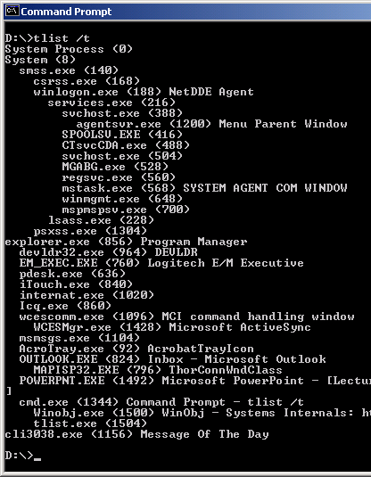
Process Creation Hierarchy
tlist.exe /t
If parent not alive, left justifies process
  Cannot see creator if creator is gone!
    e.g. explorer.exe’s parent is dead

Slide 16
System Start-up Processes (1)
First two processes are not real processes!
  Not running a user mode .EXE
  No user-mode address space
(Idle) Process id 0
Part of the loaded system image
Home for idle threads
Also called “System Process” in many displays
(System) Process id 8
Part of the loaded system image
Home for kernel-defined threads
Thread 0 launches the first “real” process, by running
smss.exe (Session Manager)

Slide 17
System Start-up Processes (2)
smss.exe Session Manager
The first “created” process
Launches required subsystems (csrss) and then
winlogon
csrss.exe Win32 subsystem
winlogon.exe Logon process: Launches services & lsass.exe; Presents first login prompt. When someone logs in, launches Userinit
services.exe Service Controller; Starts/stops Windows 2000 services (e.g. Event Log)
lsass.exe Local Security Authentication Server
userinit.exe Started after logon; starts explorer.exe and exits
explorer.exe and its children are the creators of all interactive
apps

